Slide 1
The role of cross-linguistic lexical similarity on bilingual word acquisition
Gonzalo García-Castro, Daniela Avila-Varela, Núria Sebastian-Galles
SAP seminar
September 22nd 2020

Slide 2
Bilingual lexical acquisition
One-to-three years old bilinguals show smaller conceptual vocabulary sizes than monolinguals, but similar total vocabulary sizes (e.g., Core et al. 2013).
This suggests that translation equivalents (TEs) play a central role during this stage of lexical acquisition.
At 24mo, bilinguals learning languages that share many cognates (form-similar TEs) show larger vocabularies in their additional language. This effect is larger for productive vocabulary (Floccia et al., 2018).

Slide 3
Parallel activation
Language non-selective account: bilinguals adults (e.g., Costa et al., 2000) and toddlers (Von Holzen & Mani, 2012) activate words in both languages even when only using one of them.
Translation equivalents are activated in parallel, which impacts the performance of bilinguals in both comprehension and production tasks.How does parallel activation (an on-line phenomenon) impact lexical acquisition (an off-line event)?
Anchoring networks: Words sharing high semantic (Hills et al., 2009) and/or phonological (Fourtassi et al., 2020) similarity with structured networks of aquired words are more likely to be acquired next.

Slide 4
Our study
If parallel activation plays a role in lexical acquisition:
Words in one language should aid the acquisition of words in the other.
Cognate TEs should be acquired earlier
Cognate pairs of TEs should be acquired closer in time
SPANISH (L1)
CATALAN (L2)
gato
gat
perro
gos

Slide 5
Vocabulary checklist
BiLexicon [alternative names wanted]
“mesa”: Understands, Understands and Says, None
On-line (~200/800 items per language) or lab based (~100 items per language)
16 functional/semantic categories (e.g., animals, adverbs)
Included in analyses: nouns, verbs and adjectives (Fourtassi, 2020)
Data from 696 translation equivalents (526 cognates, 172 non-cognates)

Slide 6
Vocabulary checklist
Lexical frequency: a potential confound (cognates could be more frequent)
Lexical frequencies from SUBTLEX-ESP (Cuetos et al., 2011) and SUBTLEX-CAT (Boada et al., 2019). Based on TV show subtitles (adult norms)
No differences in lexical frequency across:
Languages (𝐵𝐹₀₁ = 12.26 ± 181 0.001%)
Cognates status (𝐵𝐹₀₁ = 14.39 ± 0.000%)
Their combinations (𝐵𝐹₀₁ = 699.65 ± 0.016%).

Slide 7
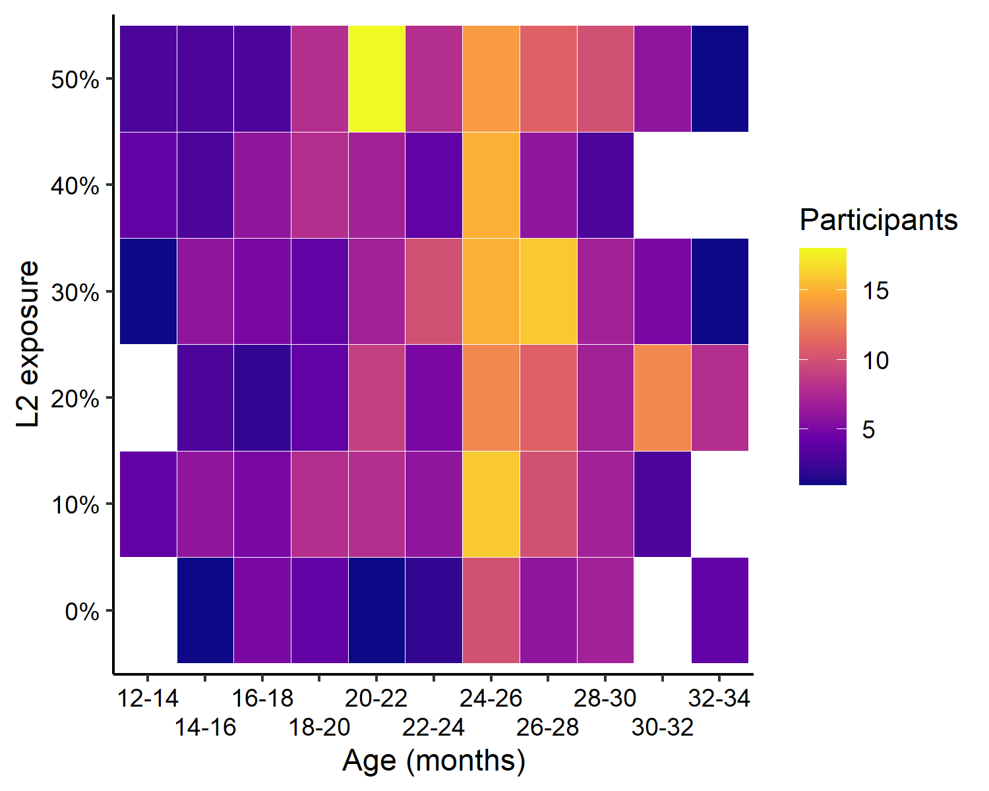
Sample
N = 437, bilinguals (12-34 mo)
Exposure to Spanish and Catalan (%) as reported by parents
Participants considered bilinguals if exposed to 5% of a 2nd language
Excluded participants with >10% exposure to a 3rd language.

Slide 8
Design
Dominance: L1 (language of most exposure) vs. L2
Item “taula” is L1 for Catalan-dominant participants
Item “mesa” is L1 for Spanish-dominant participants
Cognateness: Cognate vs. Non-cognate
TEs classified as cognates and non-cognates by two/three raters according to their phonological similarity
Dominance × Cognateness
Outcome
Proportion of infants that understan/produce each TE at different age bins.

Slide 9

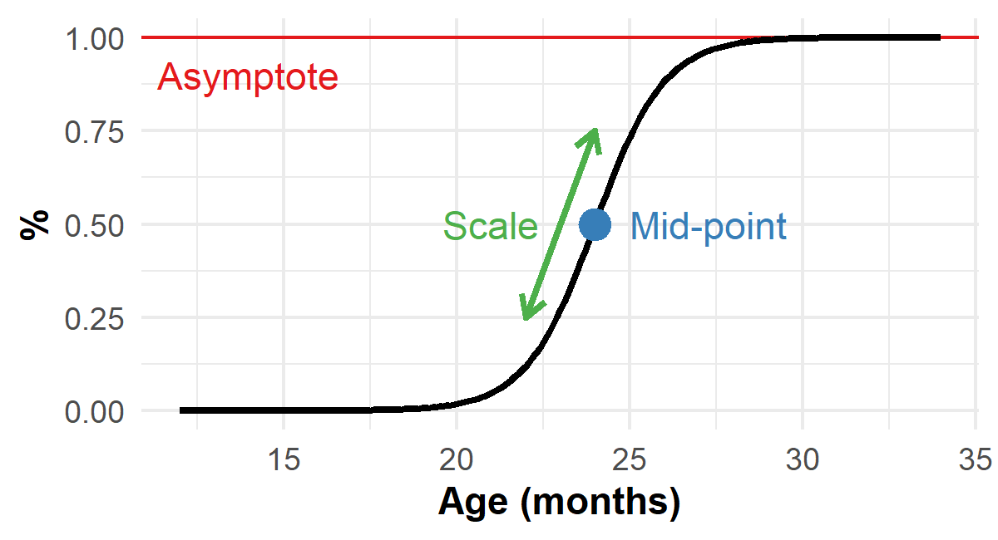
Data analysis: Logistic curves
Parameters are theoretically meaningful (Mayor & Plunkett, 2011; Mahr et al., 2020)
Growth rate relatively stable until a “sensitive age” is reached until it plateaus
Allows explicit estimation of its three parameters

Slide 10
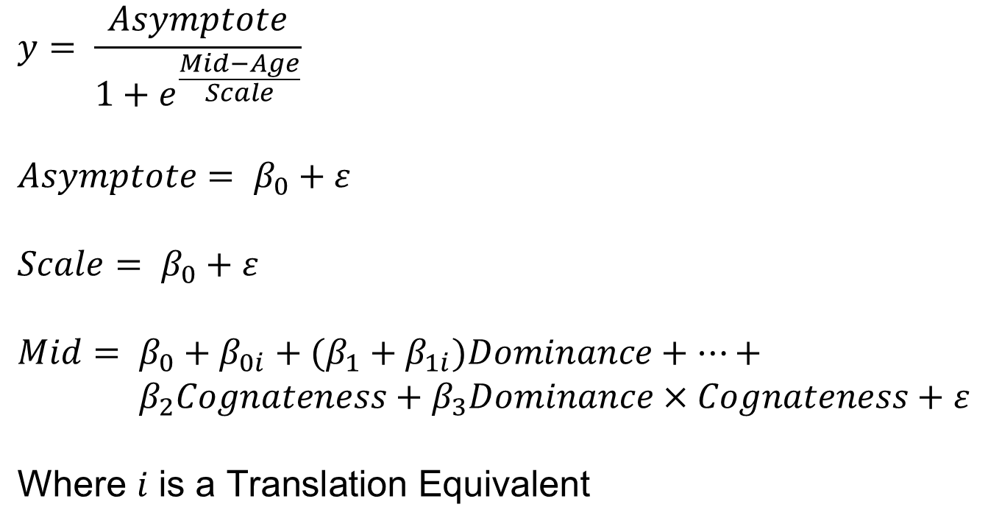
Data analysis
$$y= \frac{Asymptote}{1+e^{\frac{Mid−Age}{Scale}}}$$
$$Asymptote= β_{0}+ε$$
$$Scale= β_{0}+ε$$
$$Mid= β_{0}+{β_{0i}+(β}_{1}+β_{1i})Dominance+…+$$
$${ β}_{2}Cognateness+β_{3}Dominance×Cognateness+ε$$ $$\text{Where} i \text{is} \text{a} \text{Translation} \text{Equivalent}$$

Slide 11
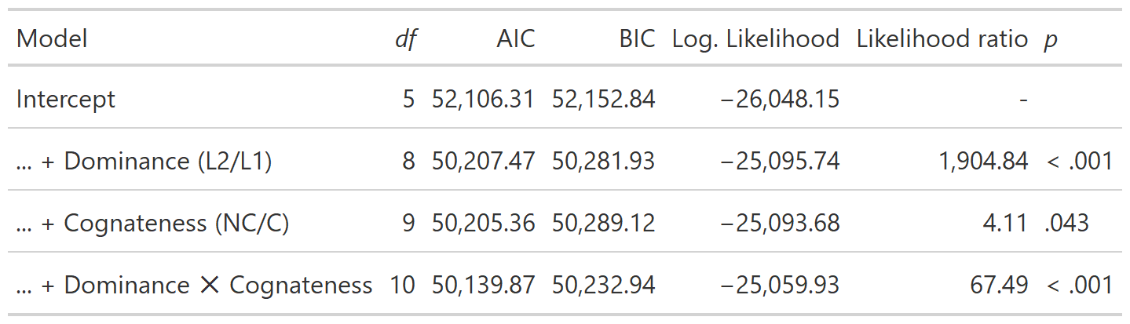
Results: production
The model that includes all main effects and interaction is the one that fits the data the best (even correcting for the number of predictors included)

Slide 12
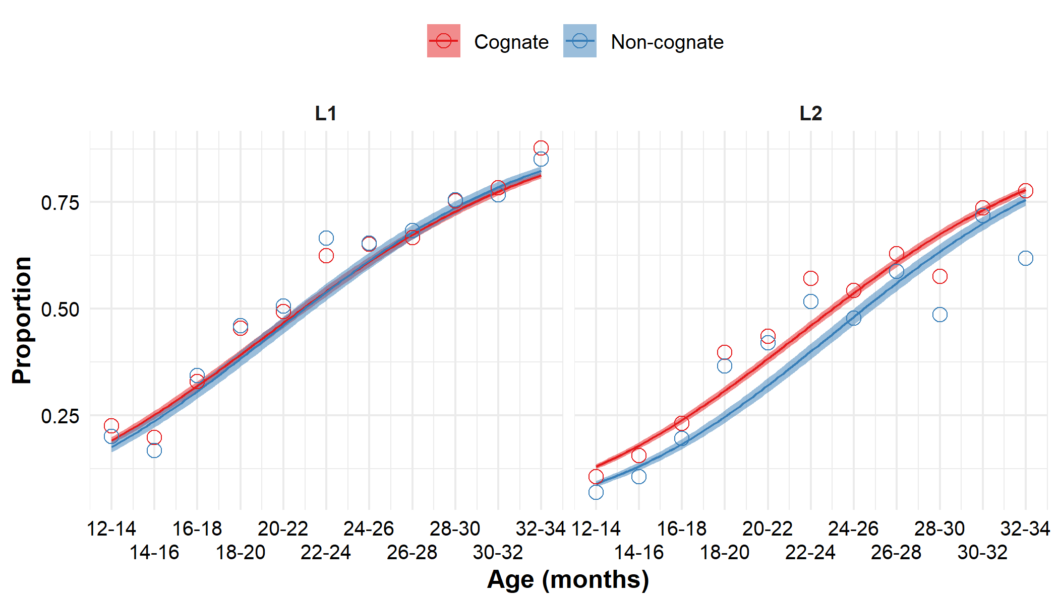
Results: comprehension

Slide 13
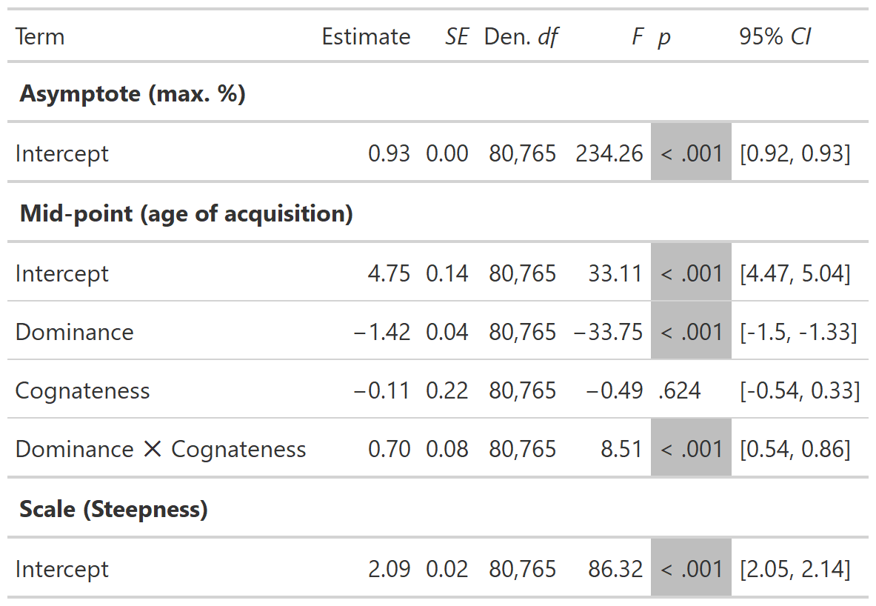
Results: comprehension
Mid-point re-scaled parameters:
Intercept: 21.5 months
Dominance: -2.84 months
Cognateness: -0.22 months
Dominance × Cognateness: 1.40 months

Slide 14
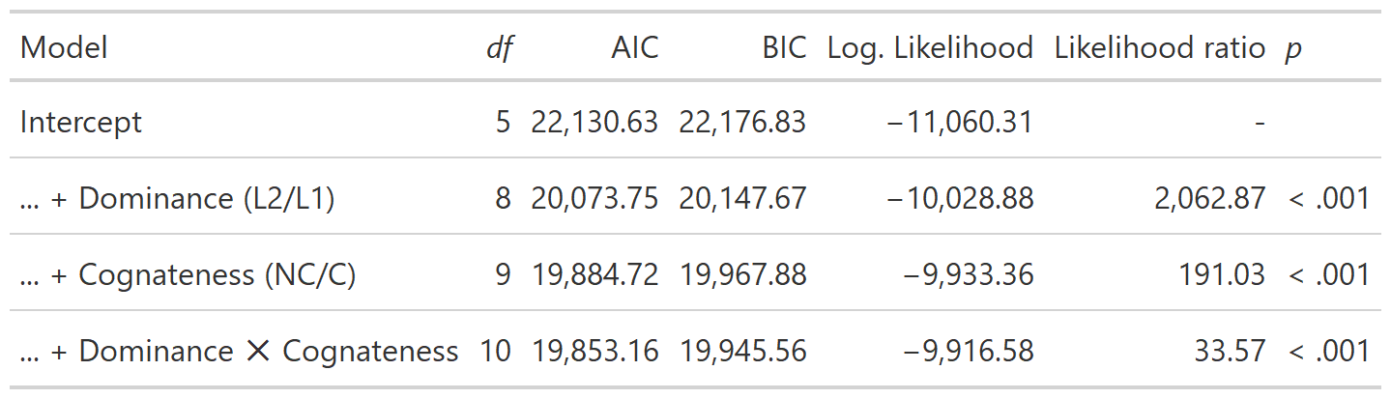
Results: production
The model that includes all main effects and interaction is the one that fits the data the best (even correcting for the number of predictors included)

Slide 15
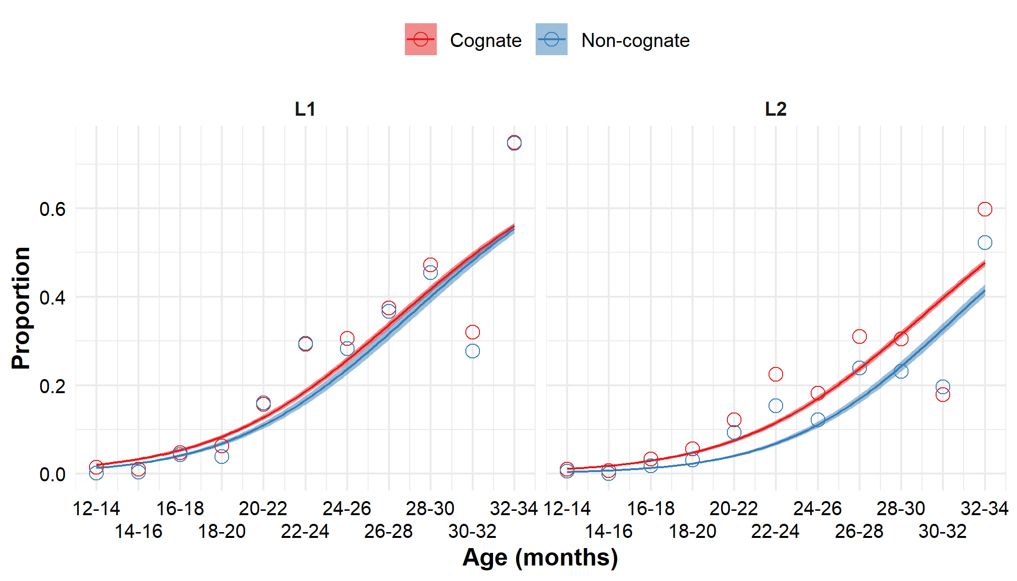
Results: production

Slide 16
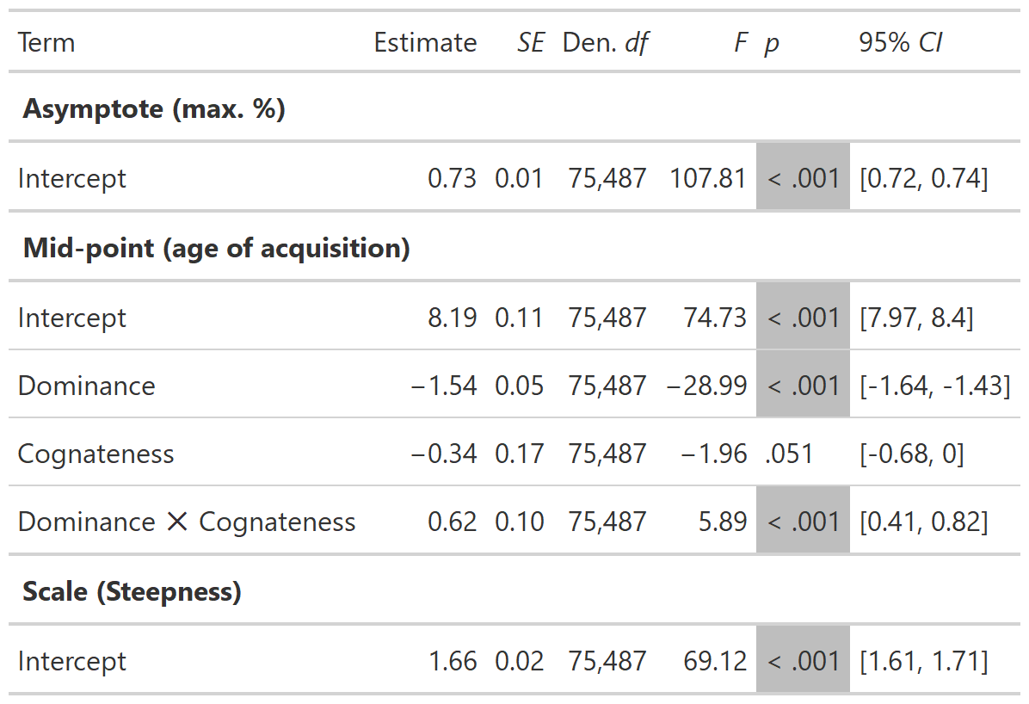
Results: production
Mid-point re-scaled parameters:
Intercept: 28.38 months
Dominance: -3.08 months
Cognateness: -0.68 months
Dominance × Cognateness: 1.24 months

Slide 17
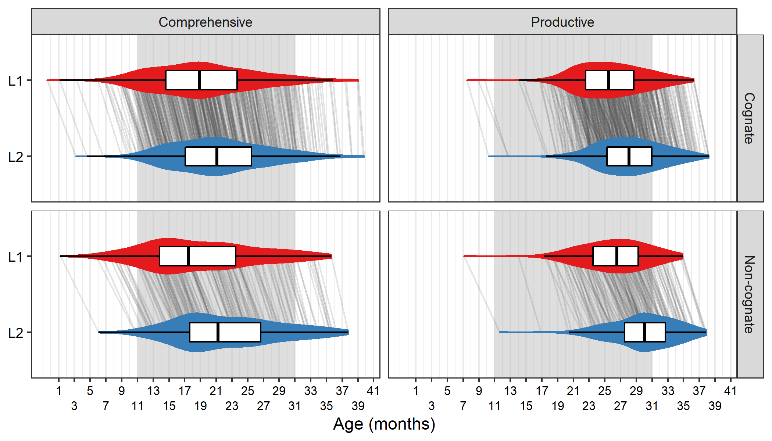
Results: predicted mid-points (AoA)

Slide 18
Discussion: Summary
During early lexical acquisition, cognates are acquired earlier than non-cognate by Catalan-Spanish bilinguals
This effect is (mostly) present in the language of least exposure (L2), and in production
Shorter time difference between the acquisition of members of cognate TEs than of non-cognate TEs
Results consistent with the parallel activation account of bilingual lexical acquisition
Next steps: more diversity of language pairs, wider age range, ideally longitudinal
Experimental evidence needed

Slide 19
Discussion: Weak points
Cross-sectional data: developmental conclusions sould be taken with care
Age range of observed data falls a bit short
N non-cognates very low relative to N cognates
Delay in production? Psychometric artifact: parents of >16 mo children are not asked to choose between comprehension or comprehension and production in the classsic CDI. More likely to report production?

Slide 20
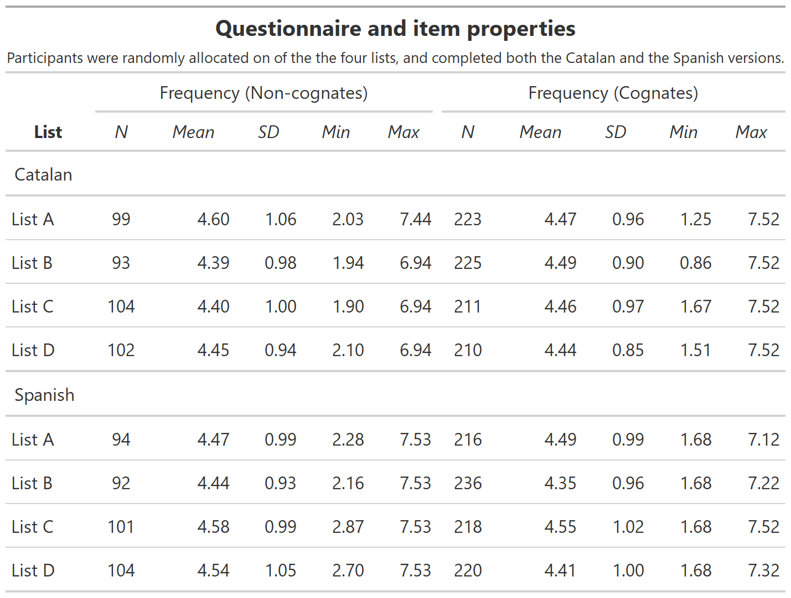
Lexical frequency

Slide 21
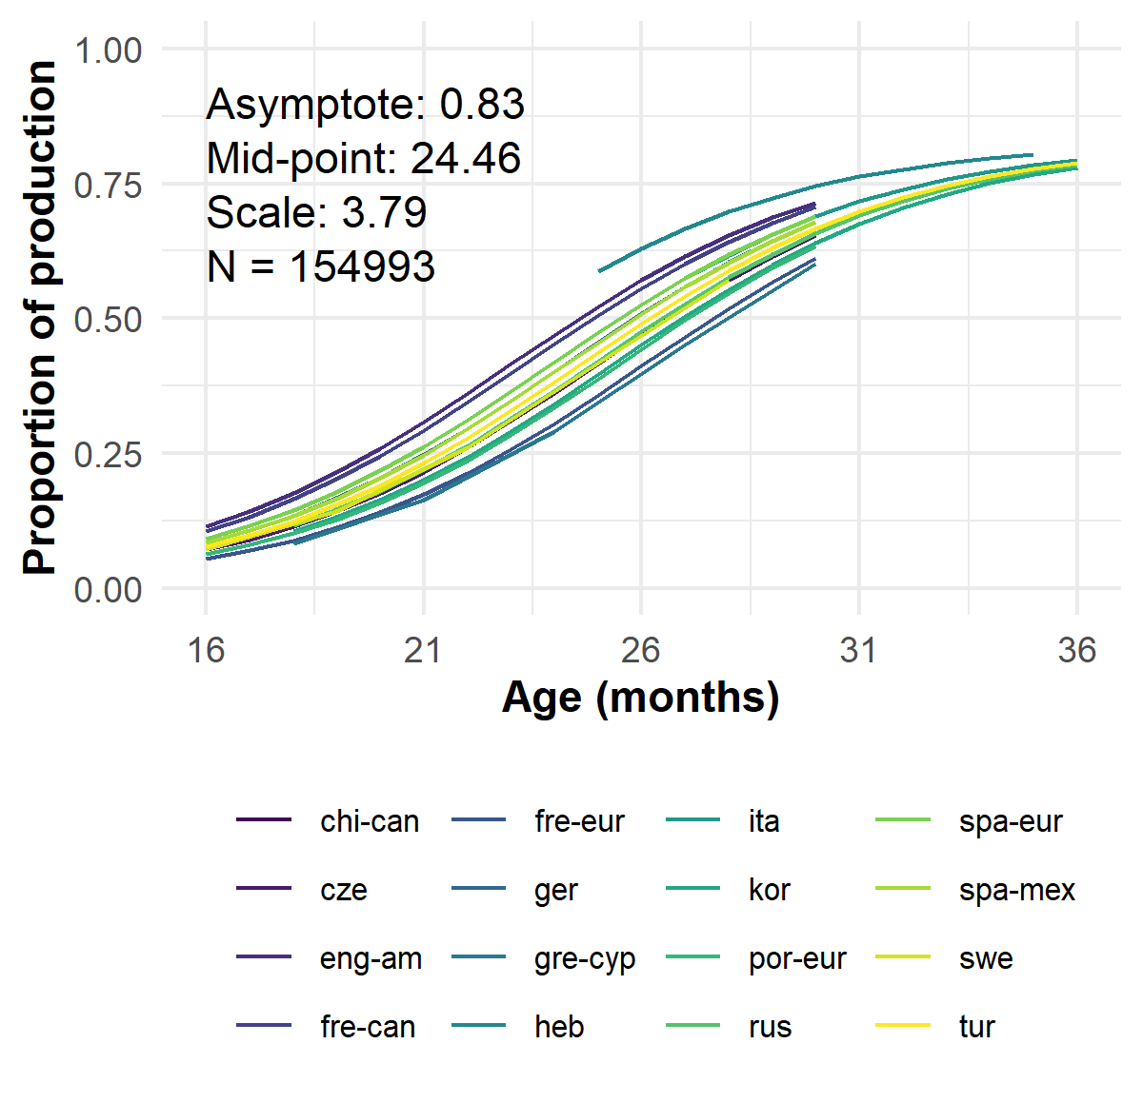
Wordbank Production only

